Slide 1


CS688 Term Project option 3 Twitter stocker
Author:Mike Zhong
01MAY2019

Slide 2
objectives
Identify stock “gainers” and “losers” for a given day
Define a gain/loss or “diff” as the (price(close) – price(open)) / price(open)
caveat: companies with very low stock prices can appear to have massive gains/losses
Once identified, use the twitter API to search for these companies in tweets
The window of tweets queried must be relevant to the day the stock market was queried
Gather tweets into a corpus, pre-process the text, identify commonly used words in each set to define a vocabulary and generate a document-term matrix
Develop custom toolkit for performing the operations described above

Slide 3
design and implementation
3 classes and their associated methods were developed to accomplish this task
These 3 classes utilize several python libraries for processing natural language, querying twitter, querying stock market data, and general data manipulation

Slide 4
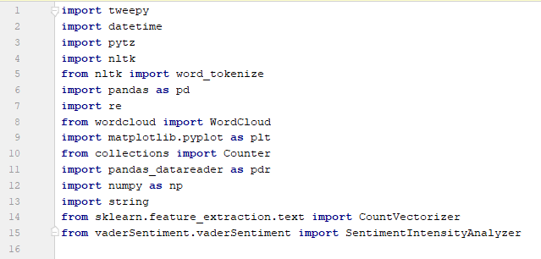
twitter_utils api PART 1) import dependencies

Slide 5
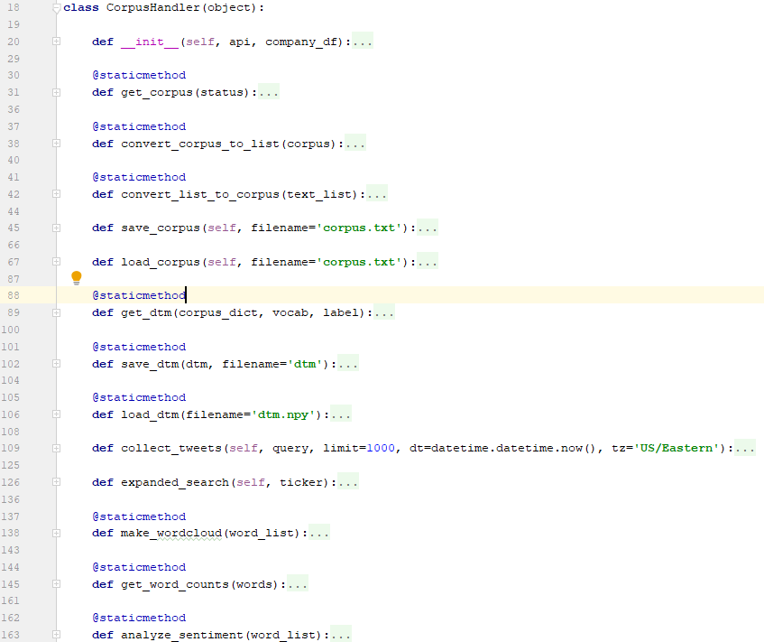
twitter_utils api PART 2) corpushandler()

Slide 6
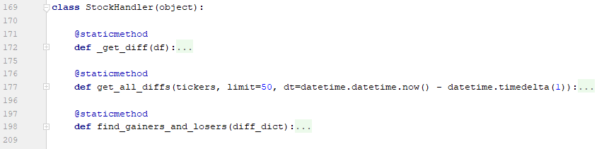
twitter_utils api PART 3) STOCKHANDLER()

Slide 7
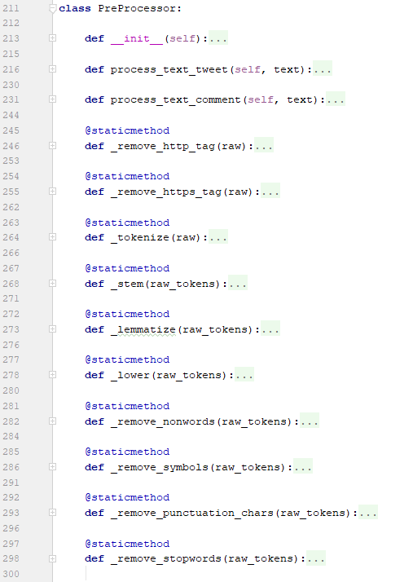
twitter_utils api PART 4) PREPROCESSOR()

Slide 8
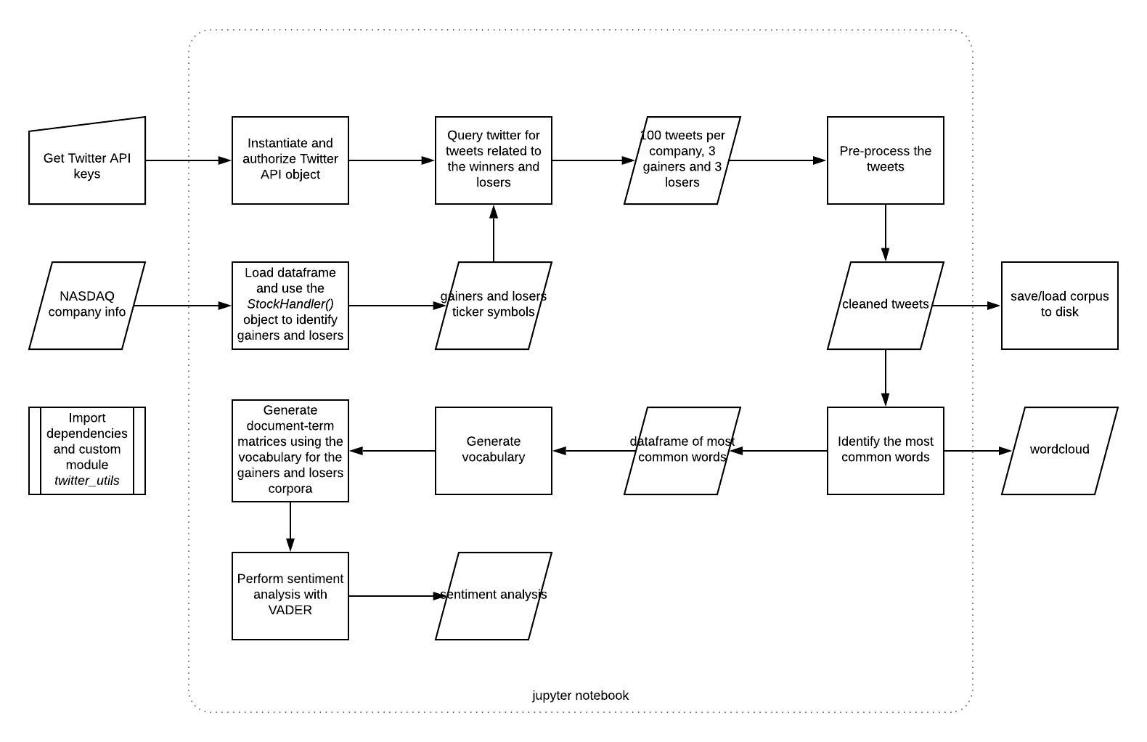
Suggested workflow

Slide 9
rUNNING THE CODE VIA JUPYTER NOTEBOOK
A jupyter notebook serves as both the driver and final report for the project
The notebook can be run but will yield different results since the date of the stock lookup and twitter searches are not pinned

Slide 10
Results
Gainers: (bold indicates 100 relevant tweets were able to be collected)
‘AMRWW’ : 1.0
‘NOVN’: 0.37
‘OXBR’: 0.26
‘LMFAW’: 0.25
‘OXBRW’: 0.25
‘PRPO’: 0.21
‘LFACW’: 0.21
‘GNMX’: 0.20
Losers: (bold indicates 100 relevant tweets were able to be collected)
‘IDEX’: -0.17
‘AUDC’: -0.17
‘CETX’: -0.18

Slide 11
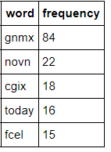
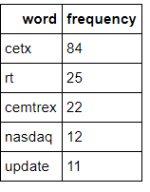
results (CONT’D)
Following pre-processing, the most common words in each corpus:
gainers:
losers:

Slide 12
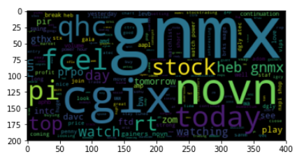
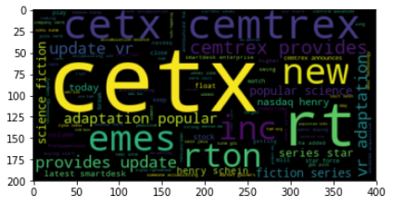
results (CONT’D)
word clouds
gainers:
losers:

Slide 13
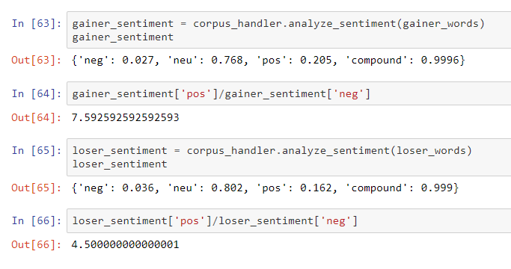
results (CONT’D)
Sentiment Analysis
gainers:
losers:

